Slide 1

Data Structure Design II
Chris Piech
CS106A, Stanford University

Slide 2
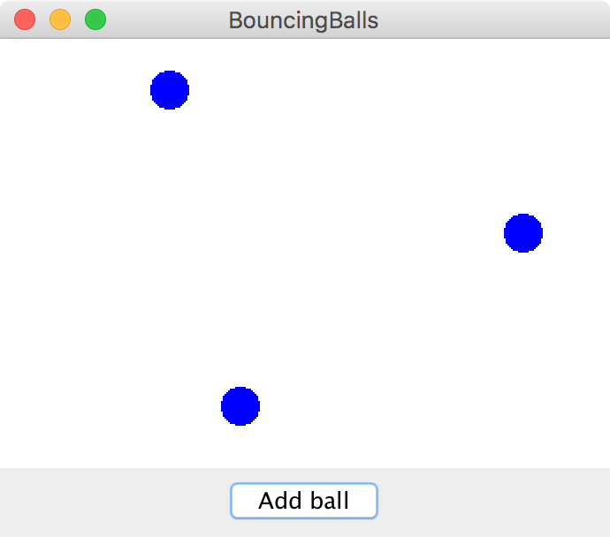
Today in lecture

Slide 3
We have used many variable types

Slide 4
E.g. GRect

Slide 5
E.g. String

Slide 6
E.g. AudioSample

Slide 7
Today we learn how to define our own

Slide 8
We use Classes (written in new files) to defined new variable types

Slide 9
You must define three things
1. What variables does each instance store?
2. What methods can you call on an instance?
3. What happens when you make a new one?
*details on how to define these three things coming soon

Slide 10
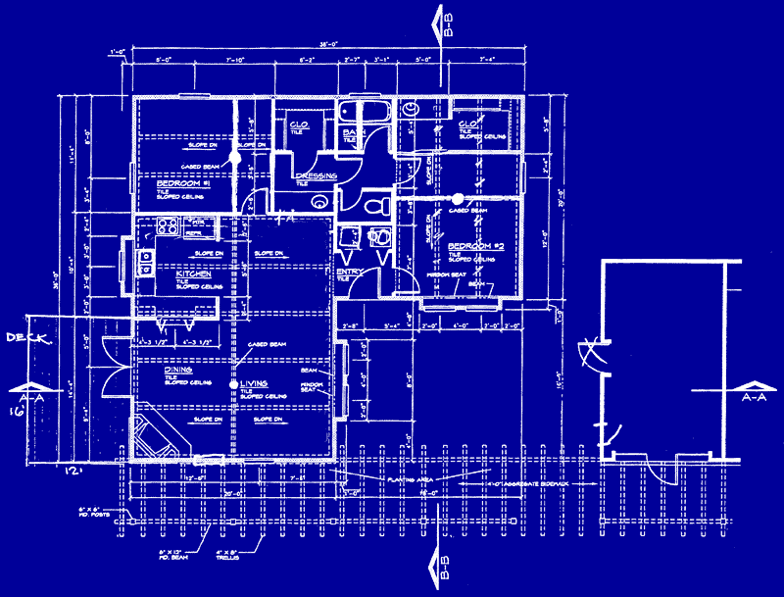
Classes are like blueprints
class: A template for a new type of variable.
Blueprint for student
A blueprint is a helpful analogy

Slide 11
What Does GRect Look Like?
GRect.java
public class GRect extends GObject {

Slide 12
What Does GRect Look Like?
GRect.java
public class GRect extends GObject {
// Instance variables
private double width = 0;
private double height = 0;
private double yc = 0;
private double xc = 0;
private boolean isFilled = false;
private boolean isVisible = false;
// Constructors
public GRect(double width, double height) {
this.width = width;
this.height = height;
}
public GRect(double x, double y, double width, double height) {
this.xc = x;
this.yc = y;
this.width = width;
this.height = height;
}
...

Slide 13
What Does GRect Look Like?
GRect.java
public class GRect extends GObject {
// Instance variables
private double width = 0;
private double height = 0;
private double yc = 0;
private double xc = 0;
private boolean isFilled = false;
private boolean isVisible = false;
// Constructors
public GRect(double width, double height) {
this.width = width;
this.height = height;
}
public GRect(double x, double y, double width, double height) {
this.xc = x;
this.yc = y;
this.width = width;
this.height = height;
}
...

Slide 14
What Does GRect Look Like?
...
// Public methods
public double getWidth() {
return this.width;
}
public double getHeight() {
return this.height;
}
public void setFilled(boolean newIsFilled) {
this.isFilled = newIsFilled;
}
public void move(double dx, double dy) {
this.xc += dx;
this.yc += dy;
}
... and so on ...
}
GRect.java

Slide 15
What does a class do?

Slide 16
A class defines a new variable type

Slide 17
Bouncing Balls

Slide 18
A Ball Variable Type
The Ball class
1. What variables does each instance store?
Each ball has its own Goval (lets call it shape)
Each ball has its own dx
Each ball has its own dy
2. What methods can you call on an instance?
heartbeat();
getShape();
3. What happens when you make a new one?
Sets initial values for all the ”instance” vars
*details on how to define these three things coming soon

Slide 19
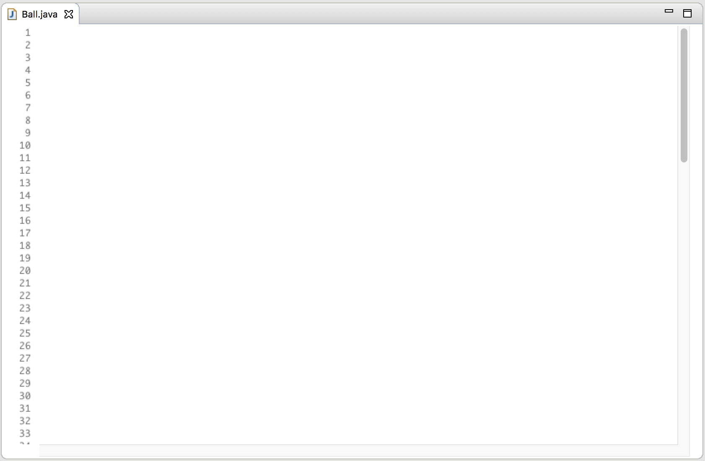
public class Ball {
/* instance vars! */
// each ball has a “shape”
private GOval shape = null;
// each ball has a dx
private double dx = 0.0;
// each ball has a dy
private double dy = 0.0;
...
1. Instance vars define what makes up a variable of type Ball

Slide 20
public class Ball {
/* instance vars! */
// each ball has a “shape”
private GOval shape = null;
// each ball has a dx
private double dx = 0.0;
// each ball has a dy
private double dy = 0.0;
// This defines what happens when you make a new ball
public Ball(int screenWidth, int screenHeight) {
RandomGenerator rg = RandomGenerator.getInstance();
double x = rg.nextInt(screenWidth - BALL_SIZE);
double y = rg.nextInt(screenHeight - BALL_SIZE);
shape = new GOval(x, y, BALL_SIZE, BALL_SIZE);
shape.setFilled(true);
shape.setColor(Color.BLUE);
dx = getRandomSpeed();
dy = getRandomSpeed();
}
...
2. The constructor defines what happens when you call new

Slide 21
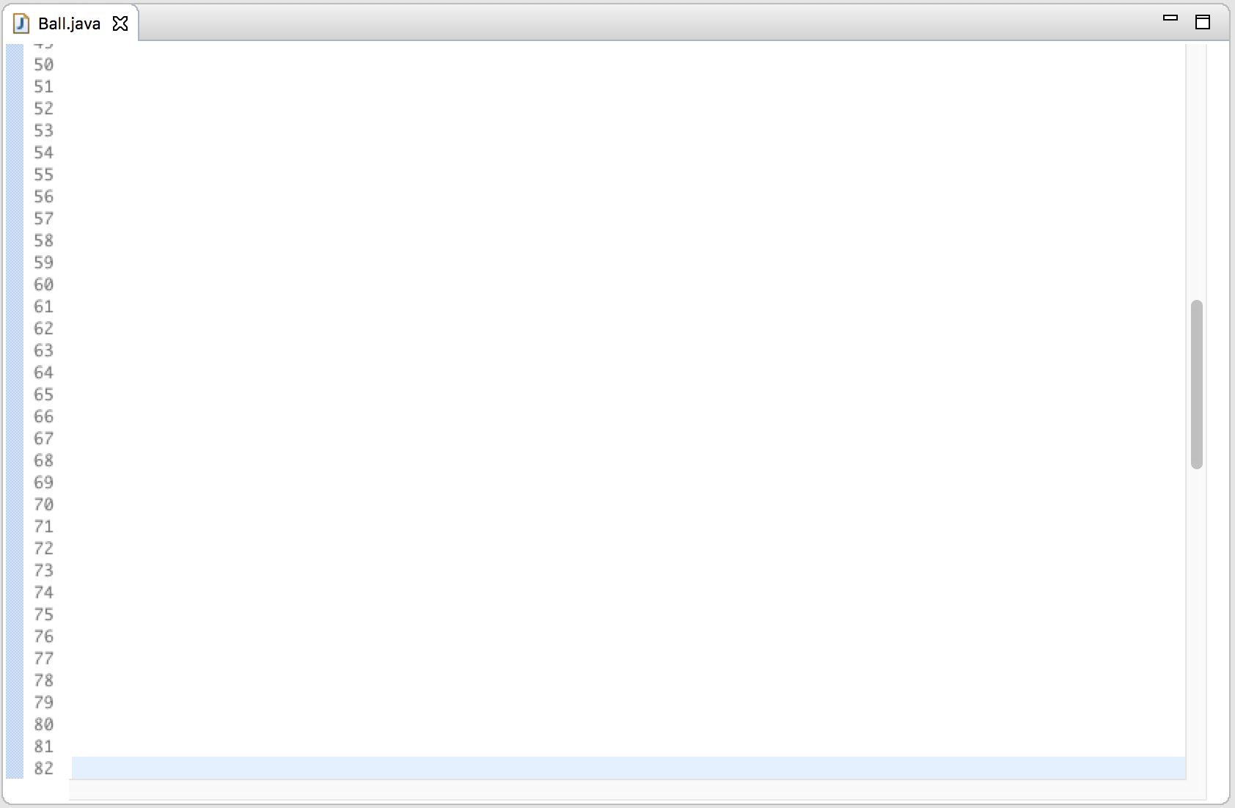
public void heartbeat(int screenWidth, int screenHeight) {
shape.move(dx, dy);
reflectOffWalls(screenWidth, screenHeight);
}
public GOval getShape() {
return shape;
}
...
3. Public methods define what methods the “client” can call on instances

Slide 22
public void heartbeat(int screenWidth, int screenHeight) {
shape.move(dx, dy);
reflectOffWalls(screenWidth, screenHeight);
}
public GOval getShape() {
return shape;
}
private void reflectOffWalls(int sWidth, int sHeight) {
if(shape.getY() < 0) {
dy *= -1;
}
if(shape.getY() > sHeight - BALL_SIZE) {
dy *= -1;
}
if(shape.getX() < 0) {
dx *= -1;
}
if(shape.getX() > sWidth - BALL_SIZE) {
dx *= -1;
}
}
4. Private methods are allowed

Slide 23
What does a class do?

Slide 24
A class defines a new variable type

Slide 25
You must define three things
1. What variables does each instance store?
2. What methods can you call on an instance?
3. What happens when you make a new one?

Slide 26
Wait… if each instance has a copy of each instance variable. How does Java know which one to use?

Slide 27
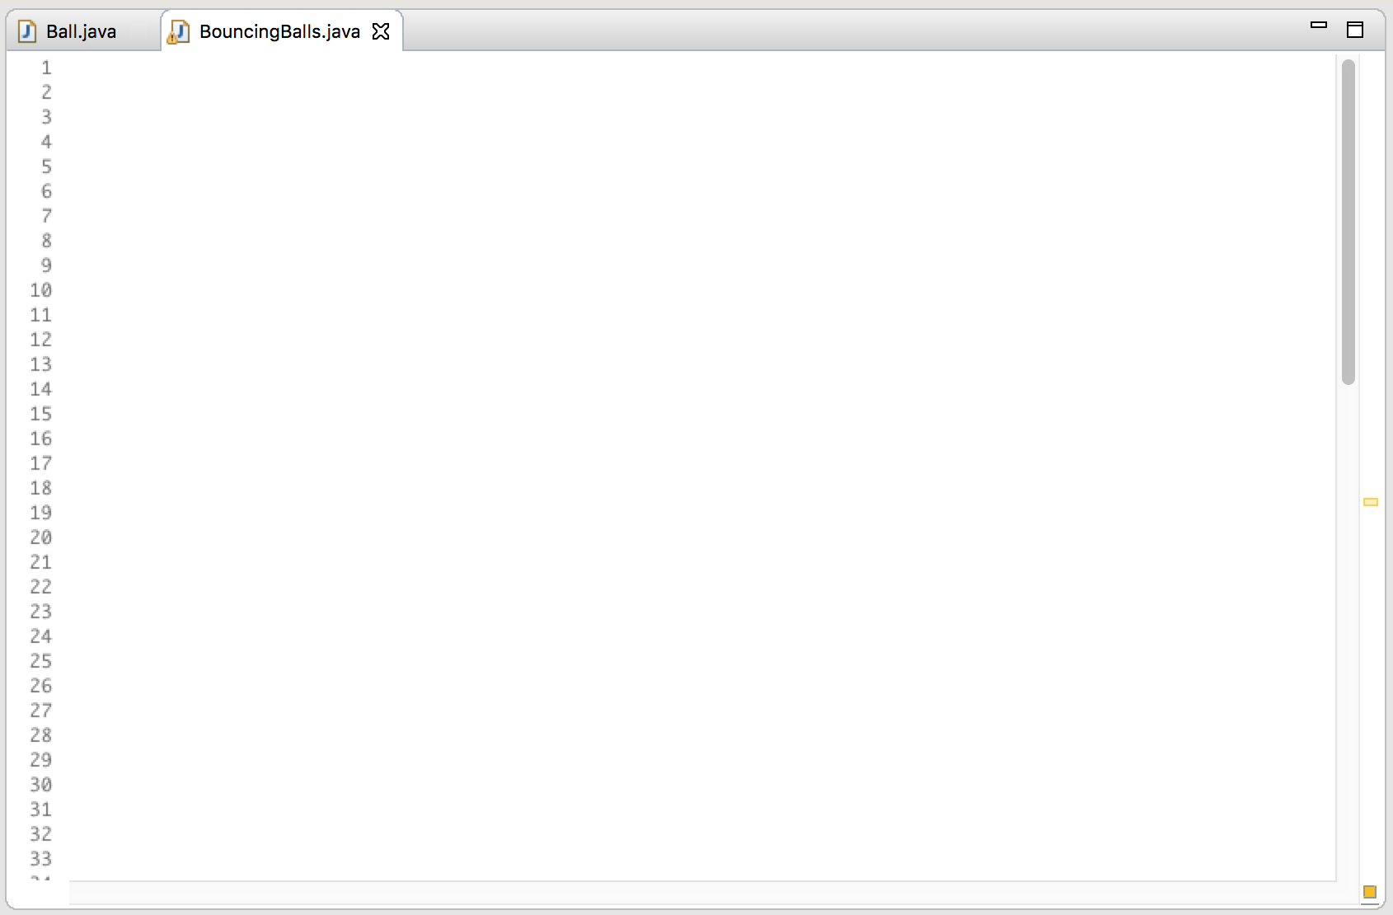
public class BouncingBalls extends GraphicsProgram {
public void run() {
// make a few new balls
Ball a = new Ball(getWidth(), getHeight());
Ball b = new Ball(getWidth(), getHeight());
// call a method on one of the balls
a.heartbeat(getWidth(), getHeight());
}
}
run
a
dx = 1.0
dy = 1.5
b
dx = -1.2
dy = -1.1

Slide 28
public class BouncingBalls extends GraphicsProgram {
public void run() {
// make a few new balls
Ball a = new Ball(getWidth(), getHeight());
Ball b = new Ball(getWidth(), getHeight());
// call a method on one of the balls
a.heartbeat(getWidth(), getHeight());
}
}
public void heartbeat(int screenWidth, int screenHeight) {
shape.move(dx, dy);
reflectOffWalls(screenWidth, screenHeight);
}
run
a
dx = 1.0
dy = 1.5
b
heartbeat
this
sWidth
800
dx = -1.2
dy = -1.1
sHidth
600

Slide 29
public class BouncingBalls extends GraphicsProgram {
public void run() {
// make a few new balls
Ball a = new Ball(getWidth(), getHeight());
Ball b = new Ball(getWidth(), getHeight());
// call a method on one of the balls
a.heartbeat(getWidth(), getHeight());
}
}
public void heartbeat(int screenWidth, int screenHeight) {
shape.move(dx, dy);
reflectOffWalls(screenWidth, screenHeight);
}
run
a
dx = 1.0
dy = 1.5
b
heartbeat
this
sWidth
800
dx = -1.2
dy = -1.1
sHidth
600

Slide 30
Tl;dr: Java knows which Ball
you called heartbeat on

Slide 31
What Does GRect Look Like?
GRect.java
public class GRect extends GObject {
// Instance variables
private double width = 0;
private double height = 0;
private double yc = 0;
private double xc = 0;
private boolean isFilled = false;
private boolean isVisible = false;
// Constructors
public GRect(double width, double height) {
this.width = width;
this.height = height;
}
public GRect(double x, double y, double width, double height) {
this.xc = x;
this.yc = y;
this.width = width;
this.height = height;
}
...

Slide 33
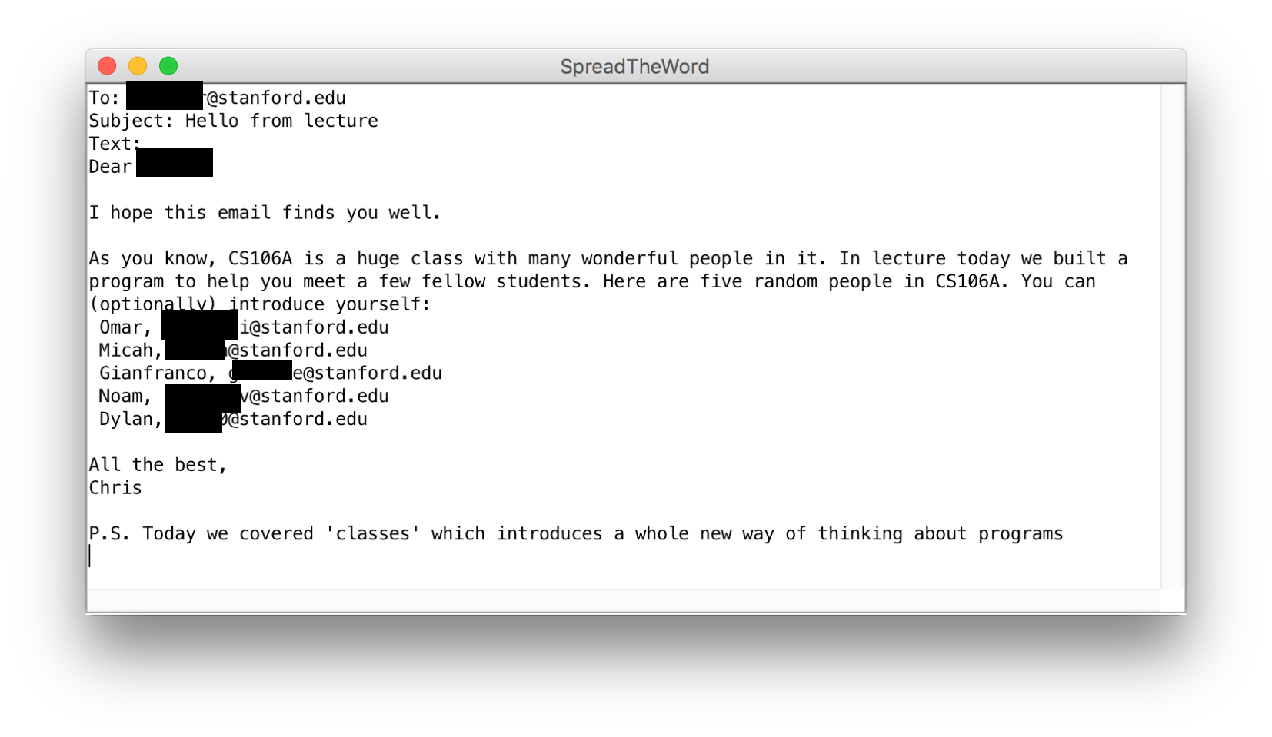

Slide 34



Slide 35
heartbeat
Tank
Fish
getImage
Wall of abstraction

Slide 36
Adding Privacy
private boolean isLeftImgShown;
encapsulation: Hiding implementation details of an object from its clients.
Encapsulation provides abstraction.
separates external view (behavior) from internal view (state)
Encapsulation protects the integrity of an object's data.
A class's instance variables should be declared private.
No code outside the class can access or change it.

Slide 37
What does a class do?

Slide 38
A class defines a new variable type

Slide 39
You must define three things
1. What variables does each instance store?
2. What methods can you call on an instance?
3. What happens when you make a new one?

Slide 40
More Practice
See Days Until

